Slide 1
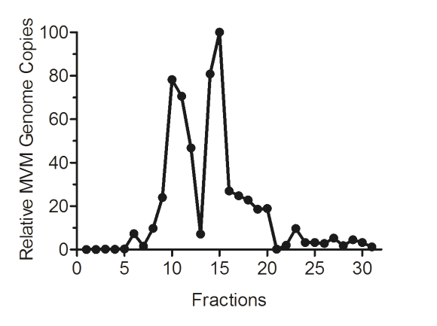
Fig. 1
A
B
C
7
8
10
11
12
13
14
15
16
17
18
19
9
20
EC

Slide 2
Fig. 2
A
B
C
D

Slide 3
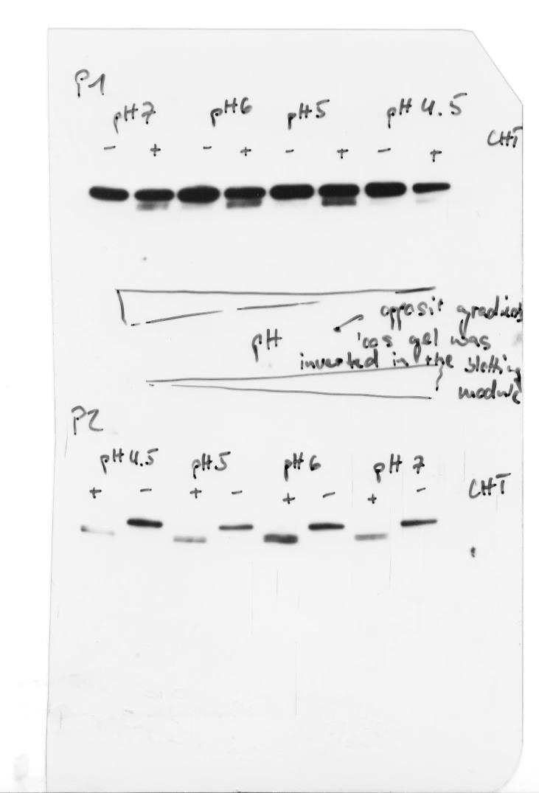
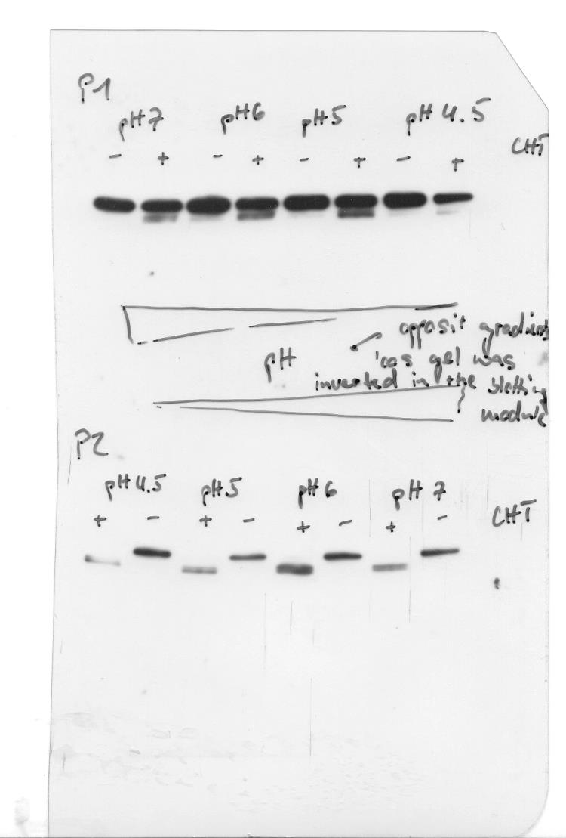
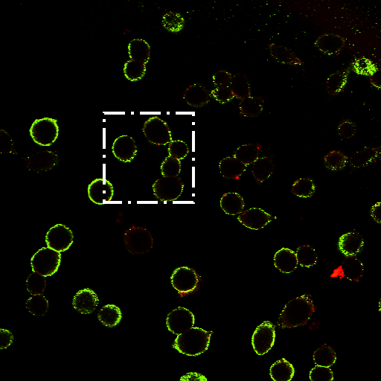
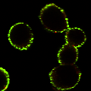
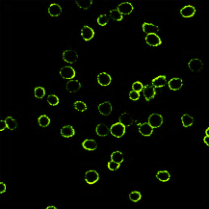
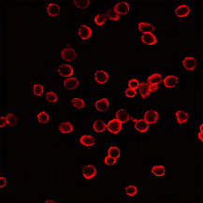
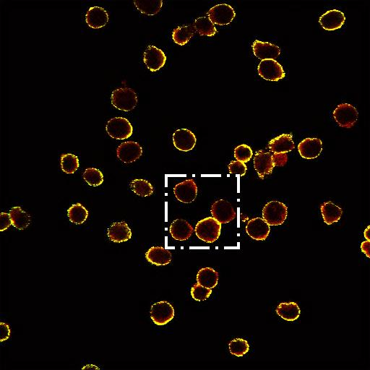
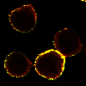
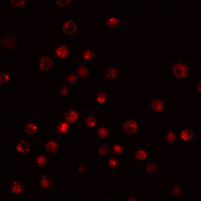
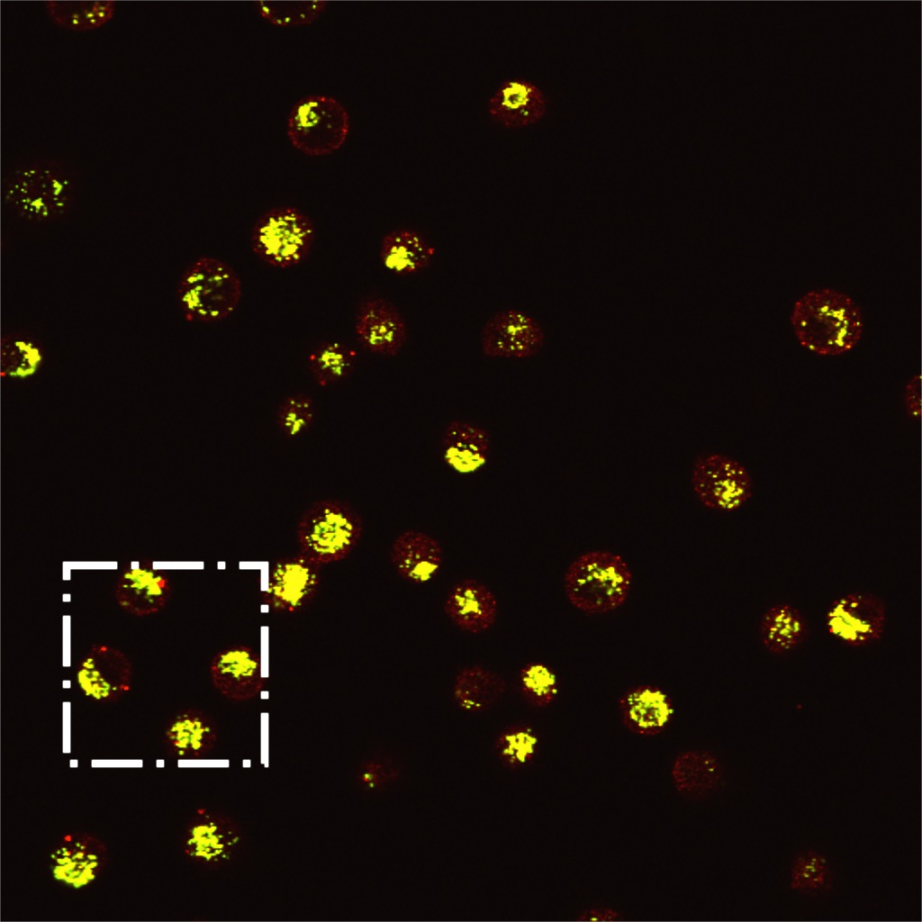
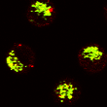
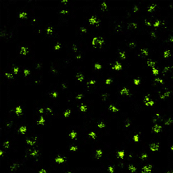
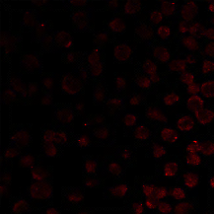
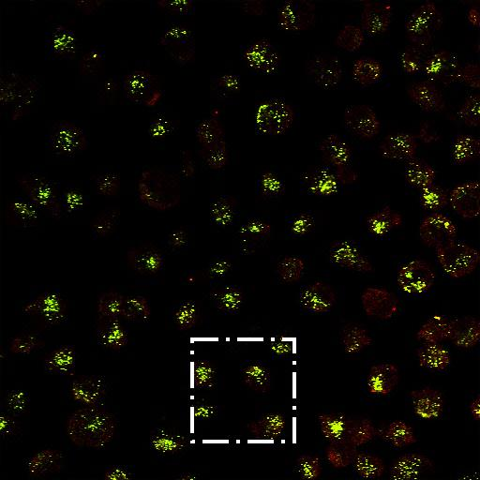
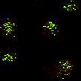
Fig. 3
A
B
C
D
E
pH 7
pH 6
pH 5
-
+
-
+
-
+
CHT
P1
VP2
VP3
P2
VP2
VP3
F
α Capsid
α N-VP2
Merge
Detailed
P1
Binding
P2
P1
4h Internalization
P2

Slide 4
Fig. 4
A
B
C
D

Slide 5
Fig. 5
A
B
C
D

Slide 6
Fig. 6

